Slide 1
Philosophy of Science
Francesco Di Iorio
francedi.iorio@gmail.com
185 5166 1135

Slide 2
The circularity problem
The validity of the theory is showed by experiments and the validity of the experiments depends on the theory
How can science settle a dispute between the proponents of opposing theories by using experimental results?
According to Chalmers, there is no circularity problem because:
(i) all experiments presuppose the validity of the theory they test plus the truth of other theories : we can criticize the validity of the tested theory independently of the experiment, i.e. by criticizing the others theories)
(ii) the results of an experiment are largely determined by the world and not by the theories

Slide 3
INDUCTION: theory can be logically derived from the facts
I observe many times that when a metal is heated it expands and I finds out a general law
1. Metal X1 expanded when heated on occasion t1.
2. Metal X2 expanded when heated on occasion t2
n. Metal Xn expanded when heated on occasion t3.
Conclusion
All metals expand when heated.

Slide 4
Scientific laws go beyond the finite amount of observable evidence that is available to support them
They can never be proven in the sense of being logically deduced from that evidence
Because of strictly logical reasons, scientific laws are uncertain

Slide 5
The probabilistic version of induction:
We observed many times (e.g. 7 millions times) that if a metal is heated it expands, then it is probably true that every time a metal is heated it expands
This variant of induction may seem intuitively plausible but it is, for logical-mathematical reasons, wrong
the probability of any general law is always zero
7 milions/ ∞ = 0

Slide 6
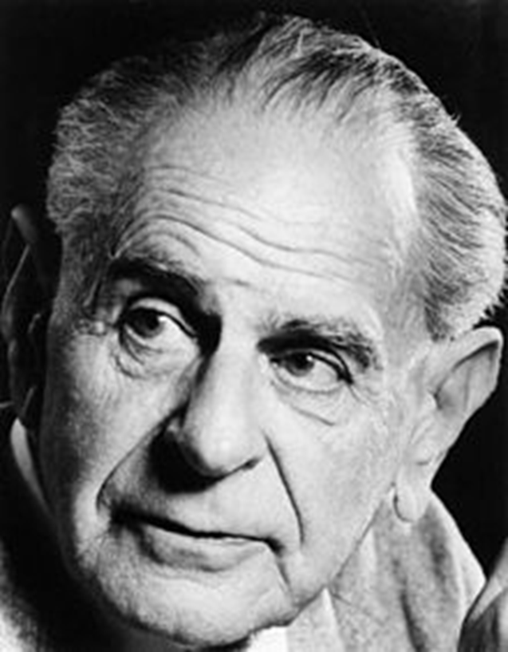
Karl R. Popper (1902-1994)

Slide 7

Austro-Hungarian Empire

Slide 8
Popper vs the Neo-positivists
Neo-positivists = Individuals are born with an empty mind (i.e. “blank slate") and learn theories through observation
Science starts from observation recurrent patterns are detected the knowledge of laws is inductively acquired
E.g. I observe 1000 swans; I saw that they are all white and I learn a new theory: “all swans are white”
This theory can be regarded as scientifically correct and certain because it is confirmed by many observations

Slide 9
Popper: Science does not use induction
Popper criticizes induction because of two reasons:
(i) a logical one: no number of positive empirical tests can confirm a theory
If I examine 1 million swans and find all of them to be white, this does not ensure that ALL swans are white

Slide 10
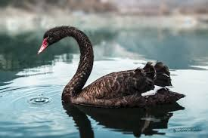
Examples of theories confirmed by many observations that have been falsified
“All swans are white” This statement was refuted when British discovered black swans in Australia

Slide 11

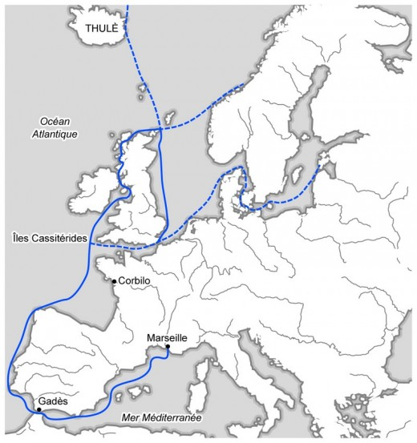
“The sun will rise and set once in every 24 h” This statement was refuted when the Greek Pytheas (350 BC – 285 BC) explored Northern Europe and discovered ‘the midnight sun

Slide 12
(ii) The second reason why Popper criticizes inductivism is that he disagrees with the idea that science starts from observations made by an empty mind (a “blank slate")
Inductivism assumes that since mind is empty, observation is pure and direct
POPPER: Observations are mental interpretations developed in the light of our biological and cultural background

Slide 13
Popper’s theory of the scientific method
Science does not begin with “pure” observation, but with PROBLEMS
Our mind is a store of biological and cultural memories (it is full of commonsense theories) and, as a consequence, it is full of expectations
Science begins with problems created by the disappointment of an expectation (anomalies)
The formulation of a new theory is never the outcome of pure observations, but it is an attempt to solve a certain problem, i.e. to solve a mystery
E.g. The first time Europeans saw that ebony does not float on water they were surprised because one of their commonsense expectations were disappointed Why ebony does not float?

Slide 14

Problems
Theories (proposed solutions)
Criticism (empirical control)
……………………………………………………………….
Science presupposes “imagination” (theories must be invented: they are creative attempts to solve problems)
Observation presuppose a problem and the invention of a theory that solve the problem (observation is used to check the validity of the proposed theories)

Slide 15
The Problem of Demarcation
The problem of demarcation is the problem of distinguishing between scientific theories and ‘non-scientific theories’
How can we understand if a new medical treatment is scientific or not?
Inductivists would argue that a treatment is scientific if it can be verified by empirical testing, but, if induction is logically impossible, no theory can be verified by empirical observation
No number of observations of white swans can demonstrate that all swans are white

Slide 16
POPPER: to solve the problem of demarcation induction must be repudiated and falsifiability must be substituted in its place
It is impossible to verify a theory by observation, so it is impossible to argue that a theory is scientific because it is verified by testing
However, it is possible to try to refute a theory (observation can show that a theory is false)
If I observe millions of white swans I cannot conclude that all swans are white, but if I observe one black swan I can conclude that it is false that all swans are white
Scientific theories are scientific not because they can be verified, but because they are falsifiable
The statement “Under standard conditions, water boils at 212 degrees Fahrenheit (100c)" is scientific not because it can been proved by observation and it has been confirmed by millions of observations, but because it can be falsified and it has never been falsified

Slide 17
Since the empirical truth of a theory cannot be proven by observation, knowledge is fallible: all theories are hypothesis and they cannot be regarded as dogmas
Fallibilism has an important consequence: if we want to increase and improve our knowledge, the only thing we can do is trying to criticize and falsify our theories
First we find a weakness of a theory, first the scientific community is obliged find a better theory
Mistakes are not shameful and bad, but learning opportunities
The progress of science is based on the attempt to falsify our knowledge

Slide 18
Examples:
1. It never rains on Wednesdays
2. All substances expand when heated
3. Heavy objects such as a brick when released near the surface of the earth fall straight downwards if not impeded

Slide 19
1. Either it is raining or it is not raining
2. All points on a circle are equidistant from the Centre
3. All bachelors an unmarried
4. Luck is possible in sporting speculation

Slide 20
Freud’s Psychoanalysis
For Freud, within every human personality there is a unconscious dimension
This is composed of instinctual impulses and the defense mechanisms repressing them – defense mechanisms linked to the internalization of the prohibitive ethical rules of civilization
According to Freud, what happens within that unconscious dimension is the key to understanding the real cause of actions in daily life.

Slide 21
Freud’s theory cannot be falsified because it can never be wrong (it could rule out nothing).
It is consistent with every kind of action
A man who pushes a child into the water with the intention of drowning it (=repression= the defense mechanisms do not work well); a man who sacrifices his life in an attempt to save a child who is drawing (=sublimation=the defense mechanisms work well)
Freud’s theory gives the appearance of being a powerful theory because it is always confirmed by facts, but it is actually a weak theory

Slide 22
Degrees of falsifiability
(a) Mars moves in an ellipse around the sun
(b) All planets move in ellipses around their sun

Slide 23
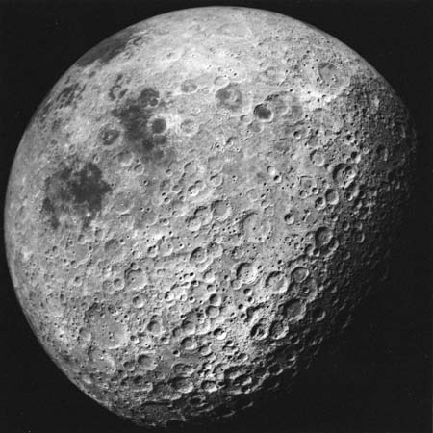
Scientists have to rule out ad hoc modifications in their theories
Ad hoc modifications are not testable hypothesis added to a theory to save it from falsification
E.g. Galileo and the lunar craters

Slide 24
POPPER: there is a difference between “logical falsification” and “methodological falsification”
This means that a fact which is contrary to a theory does not allow us to reject the theory immediately
This is because when we test a theory by searching for a counter-example, we rely on the acceptance of “a considerable amount of common background knowledge”
Consequently, sometimes the falsification can depend not on the falsity of the statement we test, but on the fact that a part of the background knowledge we use is false
While falsification is always certain from a logical point of view, it is not absolutely certain from a methodological one

